Slide 1
Programming with Java
Anan Yaagoub - PhD
Northwestern University

Slide 2
Part III - Built-ins

Slide 3
Frequently-Used Packages in JDK API
java.lang (the core package): contains classes that are core to the language itself, e.g., System, String, Math, Object, etc.
java.util: contains utilities such as Scanner, Random, Date, ArrayList, Vector, Hashtable.
java.io: contains input and output classes for reading files and I/O streams, such as File.
java.net: contains networking support, such as Socket and URL.

Slide 4
Frequently-Used Packages in JDK API
java.awt: (Abstract Windowing Toolkit): contains classes for implementing a graphical user interface, including classes like Frame, Button, CheckBox.
java.awt.event: contains event handling classes, such as key-press, mouse-click etc.
java.swing: Advanced GUI classes, e.g., JFrame, JButton, etc.
java.applet: contains classes for implementing Java applets.
java.sql: contains classes for database programming, such as Connection, Statement, ResultSet.

Slide 5
java.lang
Java core language package
It is implicitly "imported" into every Java program. That is, no explicit "import" statement required for using classes in java.lang
Frequently-used classes in "java.lang" are:
  String, StringBuffer and StringBuilder: String is immutable whereas StringBuffer/StringBuilder is mutable.
  StringBuffer is thread safe; while StringBuilder is not thread safe and is meant for single-thread operations.
Math: contains public static fields PI and E, and many public static methods such as random(), square(), sqrt(), sin(), cos(), asin(), acos(), log(), exp(), floor(), ceil(), pow(), and etc.

Slide 6
java.lang
Wrapper class for primitive types: Byte, Integer, Short, Long, Float, Double, Character, Boolean. The wrapper class is used to wrap a primitive type into a Java class. They are used when a class is needed for purpose such as using multithreading, synchronization and collection.
System: contains the public static variables in, out, and err, corresponds to the standard input, output, and error streams.
Object: the common root class for all the Java classes. This common root class defines the baseline behaviors needed to support features like multithreading (lock and monitor), synchronization (wait(), notify(), notifyAll()), garbage collection, equals(), hashcode() and toString().

Slide 7
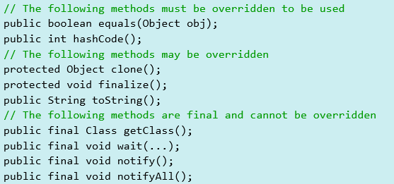
java.lang
java.lang.Object:
  is the superclass of all Java classes. In other words, all classes are subclass of Object - directly or indirectly. A reference of class Object can hold any Java object, because all Java classes are subclasses of Object. In other word, every Java class is-a Object.
  Ability to compare itself to another object, via equals() and hashcode().
  Provides a text string description, via toString().
  Inter-thread communication, via wait(), notify() and notifyAll().
  Automatic garbage collection.
  The Object class has the following public methods:

Slide 8
Part IV – Collection Framework

Slide 9
Java Collections Framework
Primitive array data type is not dynamic.
When you need to organize multiple objects in your program, you can place them into a collection
The ArrayList class is one of many collection classes that the standard Java library supplies
Collection Types: Lists, Sets, and Maps

Slide 10

Lists
Ordered Lists
  ArrayList
    Stores a list of items in a dynamically sized array
  LinkedList
    Allows speedy insertion and removal of items from the list
A list is a collection that maintains the order of its elements.

Slide 11

Sets
Unordered Sets
  HashSet
    Uses hash tables to speed up finding, adding, and removing elements
  TreeSet
    Uses a binary tree to speed up finding, adding, and removing elements
A set is an unordered collection of unique elements.

Slide 12
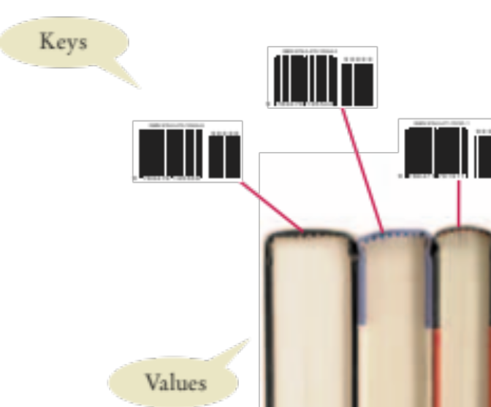
Maps
A map stores keys, values, and the associations between them
  Example:
  Barcode keys and books
Keys
  Provides an easy way to represent an object (such as a numeric bar code)
Values
  The actual object that is associated with the key
A map keeps associations
between key and value objects.

Slide 13
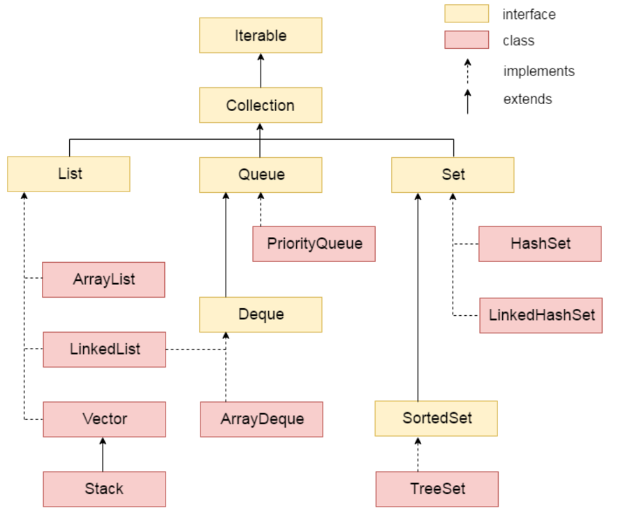
Collection Framework

Slide 14
Collection Classes and Interfaces
ArrayList class
LinkedList class
List interface
HashSet class
LinkedHashSet class
TreeSet class
PriorityQueue class
Map interface
HashMap class
LinkedHashMap class
TreeMap class
Hashtable class
Java Doc online:
http://docs.oracle.com/javase/8/docs/api/index.html

Slide 15
Iterators and Loops
Iterators are often used in while and “for-each” loops
  hasNext returns true if there is a next element
  next returns a reference to the value of the next element
  Where is the iterator in the “for-next” loop?
    It is used ‘behind the scenes’
while (iterator.hasNext())
{
String name = iterator.next();
// Do something with name
}
for (String name : employeeNames)
{
// Do something with name
}

Slide 16
Iterator interface
Iterator interface provides the facility of iterating the elements in forward direction only.
Methods of Iterator interface:
  public boolean hasNext() it returns true if iterator has more elements.
  public object next() it returns the element and moves the cursor pointer to the next element.
  public void remove() it removes the last elements returned by the iterator. It is rarely used.

Slide 17
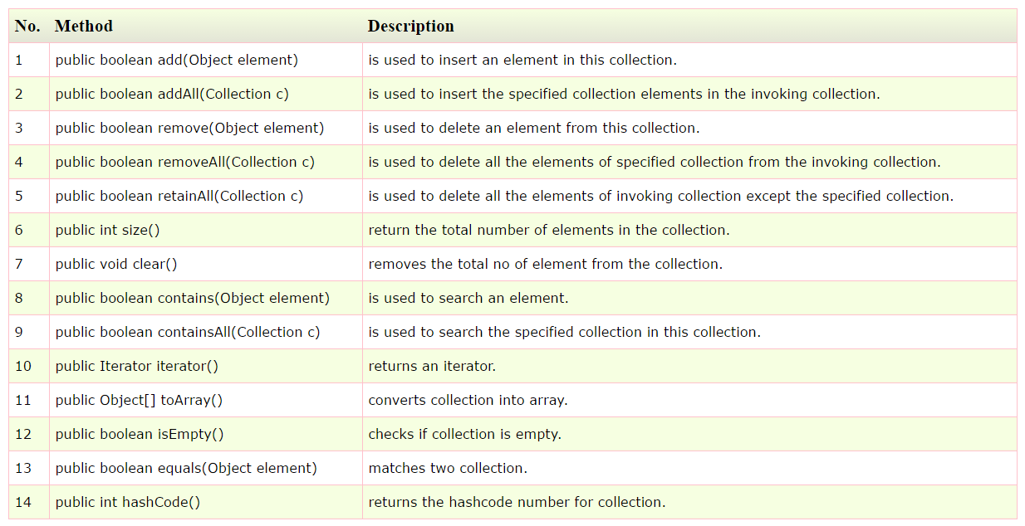
Collection interface - methods

Slide 18
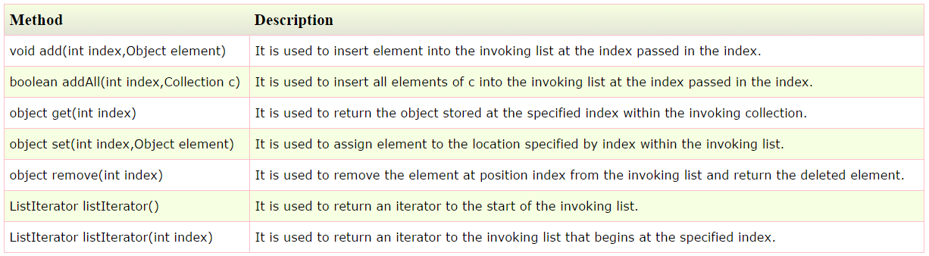
List Interface
List Interface is the sub-interface of Collection.
It contains methods to insert and delete elements in index basis.
It is a factory of ListIterator interface.

Slide 19
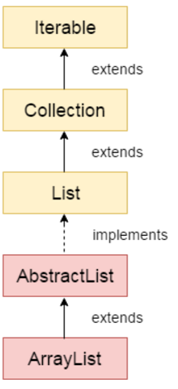
ArrayList class
can contain duplicate elements.
maintains insertion order.
is non synchronized.
allows random access because array
works at the index basis.
manipulation is slow because a lot of shifting needs to be occurred if any element is removed from the array list.

Slide 20
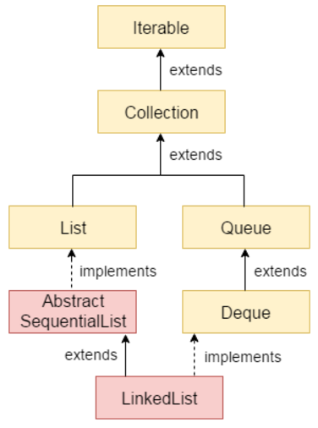
LinkedList
can contain duplicate elements.
maintains insertion order.
class is non synchronized.
class, manipulation is fast because no shifting needs to be occurred.
can be used as list, stack or queue.
In case of doubly linked list, we can add or remove elements from both side.

Slide 21
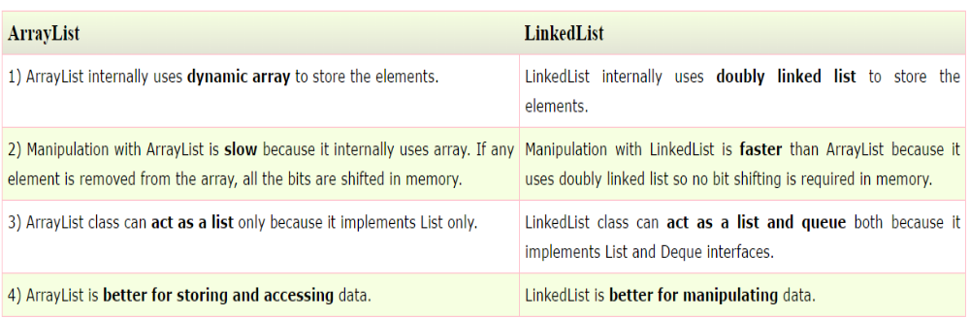
ArrayList vs LinkedList

Slide 22
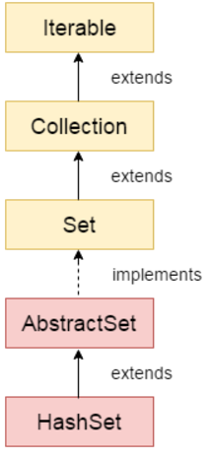
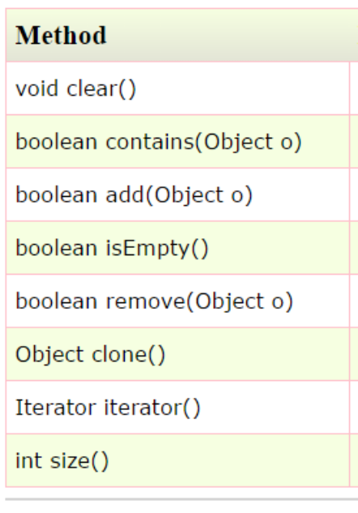
HashSet
Is used to create a collection that uses a hash table for storage.
HashSet stores the elements by using a mechanism called hashing.
HashSet contains unique elements only.
Difference between List and Set: List can contain duplicate elements whereas Set contains unique elements only.

Slide 23
LinkedHashSet
It inherits HashSet class and implements Set interface.
Contains unique elements only like HashSet.
Provides all optional set operations, and permits null elements.
Maintains insertion order.

Slide 24
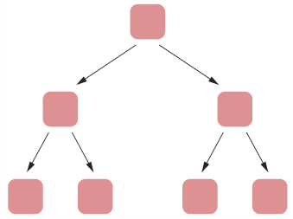
TreeSet
Java TreeSet class implements the Set interface that uses a tree for storage.
It inherits AbstractSet class
implements NavigableSet interface.
The objects of TreeSet class are stored in ascending order.
Contains unique elements only like HashSet.
Access and retrieval times are quiet fast.
Maintains ascending order.

Slide 25
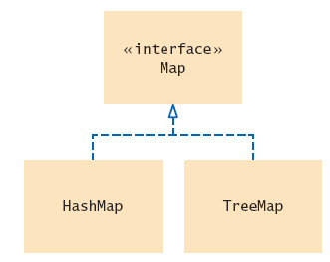
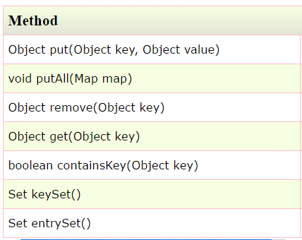
Map Interface
key and value pair.
Each key and value pair is known as an entry.
Map contains only unique keys.
Map is useful if you have to search, update or delete elements on the basis of key.

Slide 26
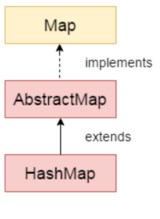
HashMap
implements the map interface by using a hashtable.
A HashMap contains values based on the key.
It contains only unique elements.
It may have one null key and multiple null values.
It maintains no order.

Slide 27
LinkedHashMap
is Hash table and Linked list implementation of the Map interface, with predictable iteration order.
contains values based on the key.
It contains only unique elements.
It may have one null key and multiple null values.
It is same as HashMap instead maintains insertion order.

Slide 28
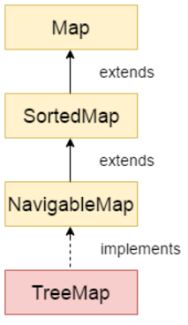
TreeMap
A TreeMap contains values based on the key.
It contains only unique elements.
It cannot have null key but can have multiple null values.
It is same as HashMap instead maintains ascending order.

Slide 29
HashTable
implements a hashtable, which maps keys to values.
A Hashtable is an array of list.
Each list is known as a bucket.
The position of bucket is identified by calling the hashcode() method.
A Hashtable contains values based on the key.
It contains only unique elements.
It may have not have any null key or value.
It is synchronized.

Slide 30
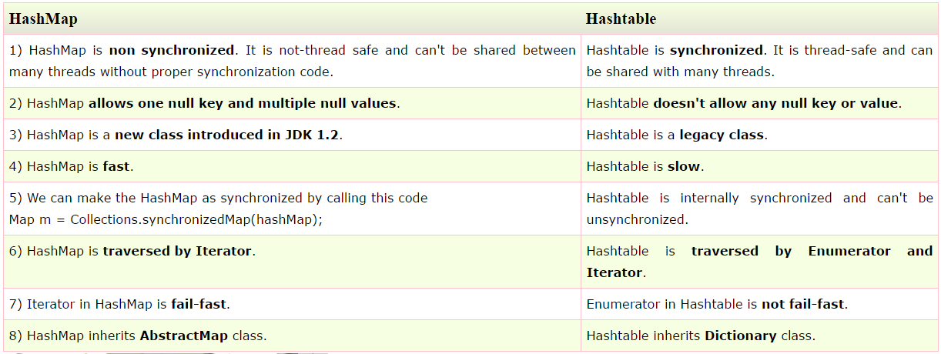
HashMap vs Hashtable

Slide 31
Steps to Choosing a Collection
1) Determine how you access values
  Values are accessed by an integer position. Use an ArrayList
    Go to Step 2, then stop
  Values are accessed by a key that is not a part of the object
    Use a Map.
  It doesn’t matter. Values are always accessed “in bulk”, by traversing the collection and doing something with each value
2) Determine the element types or key/value types
  For a List or Set, a single type
  For a Map, the key type and the value type

Slide 32
Steps to Choosing a Collection
3) Determine whether element or key order matters
  Elements or keys must be sorted
    Use a TreeSet or TreeMap. Go to Step 6
  Elements must be in the same order in which they were inserted
    Your choice is now narrowed down to a LinkedList or an ArrayList
  It doesn’t matter
    If you chose a map in Step 1, use a HashMap and go to Step 5

Slide 33
Steps to Choosing a Collection
4) For a collection, determine which operations must be fast
  Finding elements must be fast
    Use a HashSet and go to Step 5
  Adding and removing elements at the beginning or the middle must be fast
    Use a LinkedList
  You only insert at the end, or you collect so few elements that you aren’t concerned about speed
    Use an ArrayList.

Slide 34
Steps to Choosing a Collection
5) For hash sets and maps, decide if you need to implement the equals and hashCode methods
  If your elements do not support them, you must implement them yourself.
6) If you use a tree, decide whether to supply a comparator
  If your element class does not provide it, implement the Comparable interface for your element class
Extra Examples: http://math.hws.edu/javanotes/c10/s4.html

Slide 35
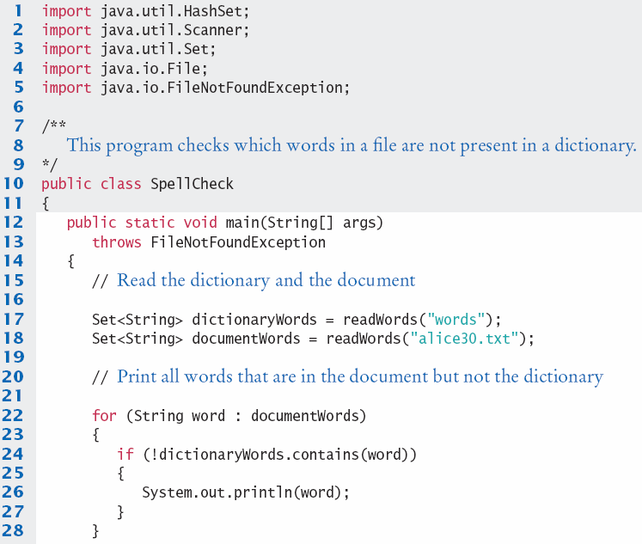
SpellCheck.java (1)

Slide 36
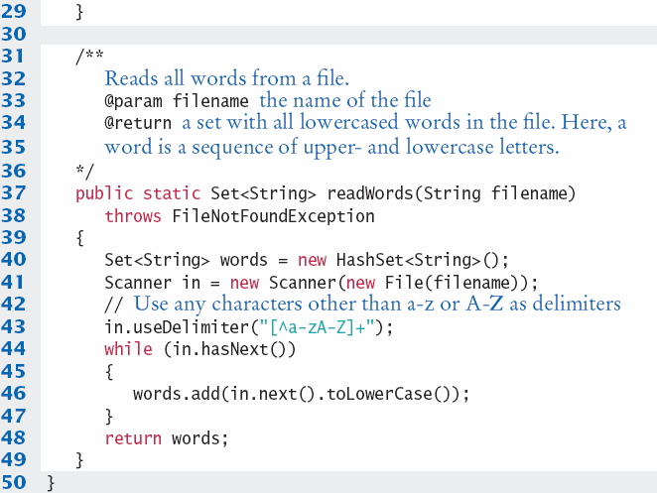
SpellCheck.java (2)
Example: SpellCheck.java
Example: WordCount.java

